Slide 1
Demystifying Contrastive Self-Supervised Learning: Invariances, Augmentations and Dataset Biases
Senthil Purushwalkam (CMU) Abhinav Gupta (CMU, FAIR)
Email: spurushw@cs.cmu.edu

Slide 2
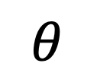
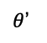
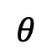

Self-supervised Learning: Definition and Goals
Definition:
An approach to learn a feature representation from data without human supervision
Goal:
Learn a good feature extractor or an initialization that is useful for a wide range of tasks or a specific task that you care about
$$θ$$
Feature
$$θ$$
Loss
Function
ImageNet
$$θ$$
Dog!
$θ$’
Dog!

Slide 3
Slide by Andrew Zisserman taken from https://project.inria.fr/paiss/files/2018/07/zisserman-self-supervised.pdf

Slide 4
Overview of SSL Approaches
Derive some form of supervision from the unlabeled data available
The Three ‘C’s of SSL: Compression, Completion, Clustering
Compression: Learn a representation that allows accurate reconstruction of the data (or a relevant part of it)
Completion: Hide a part of the data, learn to predict it conditioned on the other parts
Clustering: Learn a representation that clusters according to some constraints

Slide 5
Focus of today’s presentation
Completion and Clustering based approaches that were popular pre-2019
Latest line of research on instance classification
Minimal focus on quantitative results
What is not covered:
Compression-based approaches – very little evidence of efficacy
‘Active’ data (robotics, simulation, etc)
Multi-modal data based learning

Slide 6
The Era of Designing Pretext Tasks
200x - 2019
Compression
Completion
Clustering
Compressed data representations that allow reconstruction of the data
Hide a part of the data, learn to predict it using the non-hidden part
Learn a representation that clusters according to a hand-crafted constraint
Vincent, Pascal, et al. "Extracting and composing robust features with denoising autoencoders." Proceedings of the 25th international conference on Machine learning. 2008.
Radford, Alec, Luke Metz, and Soumith Chintala. "Unsupervised representation learning with deep convolutional generative adversarial networks." arXiv preprint arXiv:1511.06434 (2015).
Zhuang, Fuzhen, et al. "Supervised representation learning: Transfer learning with deep autoencoders." Twenty-Fourth International Joint Conference on Artificial Intelligence. 2015.
Pathak, Deepak, et al. "Context encoders: Feature learning by inpainting." Proceedings of the IEEE conference on computer vision and pattern recognition. 2016.
Zhang, Richard, Phillip Isola, and Alexei A. Efros. "Colorful image colorization." European conference on computer vision. Springer, Cham, 2016.
Vondrick, Carl, Hamed Pirsiavash, and Antonio Torralba. "Generating videos with scene dynamics." Advances in neural information processing systems. 2016.
Zhao, Qilu, and Zongmin Li. "Unsupervised Representation Learning with Laplacian Pyramid Auto-encoders." arXiv preprint arXiv:1801.05278 (2018).
Zhang, Liheng, et al. "Aet vs. aed: Unsupervised representation learning by auto-encoding transformations rather than data." Proceedings of the IEEE Conference on Computer Vision and Pattern Recognition. 2019.
Doersch, Carl, Abhinav Gupta, and Alexei A. Efros. "Unsupervised visual representation learning by context prediction." Proceedings of the IEEE International Conference on Computer Vision. 2015.
Agrawal, Pulkit, Joao Carreira, and Jitendra Malik. "Learning to see by moving." Proceedings of the IEEE international conference on computer vision. 2015.
Wang, Xiaolong, and Abhinav Gupta. "Unsupervised learning of visual representations using videos." Proceedings of the IEEE International Conference on Computer Vision. 2015.
Misra, Ishan, C. Lawrence Zitnick, and Martial Hebert. "Shuffle and learn: unsupervised learning using temporal order verification." European Conference on Computer Vision. Springer, Cham, 2016.
Noroozi, Mehdi, and Paolo Favaro. "Unsupervised learning of visual representations by solving jigsaw puzzles." European Conference on Computer Vision. Springer, Cham, 2016.
Li, Dong, et al. "Unsupervised visual representation learning by graph-based consistent constraints." European Conference on Computer Vision. Springer, Cham, 2016.
Pathak, Deepak, et al. "Learning features by watching objects move." Proceedings of the IEEE Conference on Computer Vision and Pattern Recognition. 2017.
Gidaris, Spyros, Praveer Singh, and Nikos Komodakis. "Unsupervised representation learning by predicting image rotations." arXiv preprint arXiv:1803.07728 (2018).
Wang, Xiaolong, and Abhinav Gupta. "Unsupervised learning of visual representations using videos." Proceedings of the IEEE International Conference on Computer Vision. 2015.
Jayaraman, Dinesh, and Kristen Grauman. "Learning image representations tied to ego-motion." Proceedings of the IEEE International Conference on Computer Vision. 2015.
Bojanowski, Piotr, and Armand Joulin. "Unsupervised learning by predicting noise." Proceedings of the 34th International Conference on Machine Learning-Volume 70. JMLR. org, 2017.
Yan, Xueting, et al. "ClusterFit: Improving Generalization of Visual Representations." arXiv preprint arXiv:1912.03330 (2019).
Wu, Zhirong, et al. "Unsupervised feature learning via non-parametric instance discrimination." Proceedings of the IEEE Conference on Computer Vision and Pattern Recognition. 2018.
Oord, Aaron van den, Yazhe Li, and Oriol Vinyals. "Representation learning with contrastive predictive coding." arXiv preprint arXiv:1807.03748 (2018).
He, Kaiming, et al. "Momentum contrast for unsupervised visual representation learning." arXiv preprint arXiv:1911.05722 (2019).
Misra, Ishan, and Laurens van der Maaten. "Self-supervised learning of pretext-invariant representations." arXiv preprint arXiv:1912.01991 (2019).

Slide 7
Pre-2019: Hand-Crafted Pretext Tasks
Tracking to mine semantically similar pairs of patches
Sample negative patches from random videos
Train a CNN with a `triplet loss’: where a_i, p_i are features of the mined pair and n_i is that of the negative patch
Wang, Xiaolong, and Abhinav Gupta. "Unsupervised learning of visual representations using videos." Proceedings of the IEEE International Conference on Computer Vision. 2015.

Slide 8
Pre-2019: Hand-Crafted Pretext Tasks
Features learned are trained to be invariant to viewpoint changes, illumination changes, deformations, etc
Wang, Xiaolong, and Abhinav Gupta. "Unsupervised learning of visual representations using videos." Proceedings of the IEEE International Conference on Computer Vision. 2015.

Slide 9
Pre-2019: Hand-Crafted Pretext Tasks
Predict relative location of patches in images
Train a CNN for the 8-way classification problem given features of two patches
Solving this task requires encoding of object parts (or some `understanding’ of the arrangement of patches)
Doersch, Carl, Abhinav Gupta, and Alexei A. Efros. "Unsupervised visual representation learning by context prediction." Proceedings of the IEEE International Conference on Computer Vision. 2015.

Slide 10
Pre-2019: Hand-Crafted Pretext Tasks
Predict relative location of frames in time
Train on human action videos
Triplets of frames
Perform binary classification – correct vs incorrect order
Solving this task requires encoding of state in an action or general motions
Misra, Ishan, C. Lawrence Zitnick, and Martial Hebert. "Shuffle and learn: unsupervised learning using temporal order verification." European Conference on Computer Vision. Springer, Cham, 2016.

Slide 11
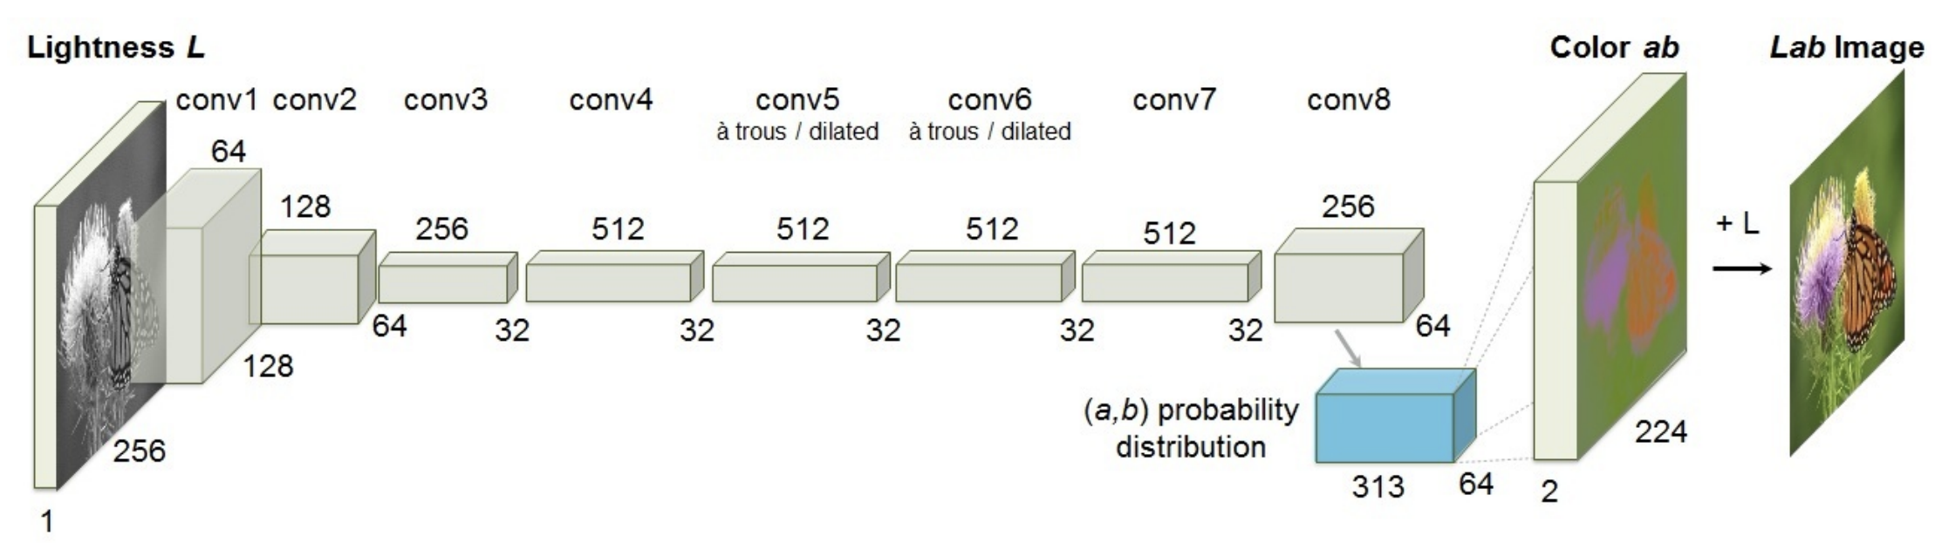
Pre-2019: Hand-Crafted Pretext Tasks
Predict colors for a grayscale image
Lab color space “Because distances in this space model perceptual distance”
Quantize the ab space into 313 bins
Train for 313-way classification
Solving this task requires understanding of objects since colors are closely tied to semantics
Zhang, Richard, Phillip Isola, and Alexei A. Efros. "Colorful image colorization." European conference on computer vision. Springer, Cham, 2016.

Slide 12
Pre-2019: Hand-Crafted Pretext Tasks
Predict rotation of an image
Train CNN for 4-way classification – 0, 90, 180, 270
Intuition: Unclear ? Rotation is tied to semantics
Gidaris, Spyros, Praveer Singh, and Nikos Komodakis. "Unsupervised representation learning by predicting image rotations." arXiv preprint arXiv:1803.07728 (2018).

Slide 13
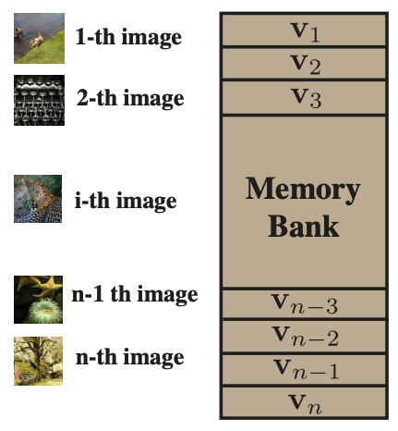
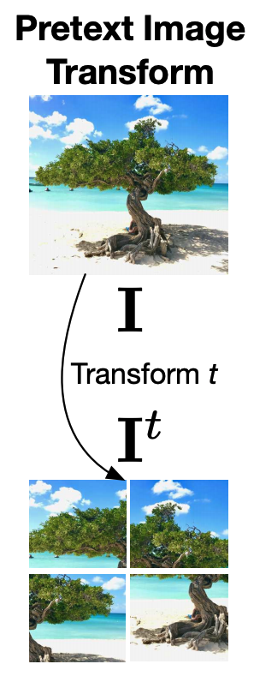
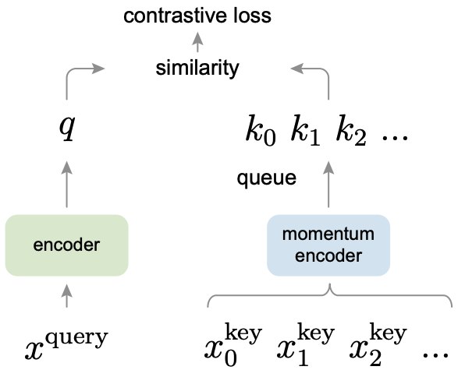
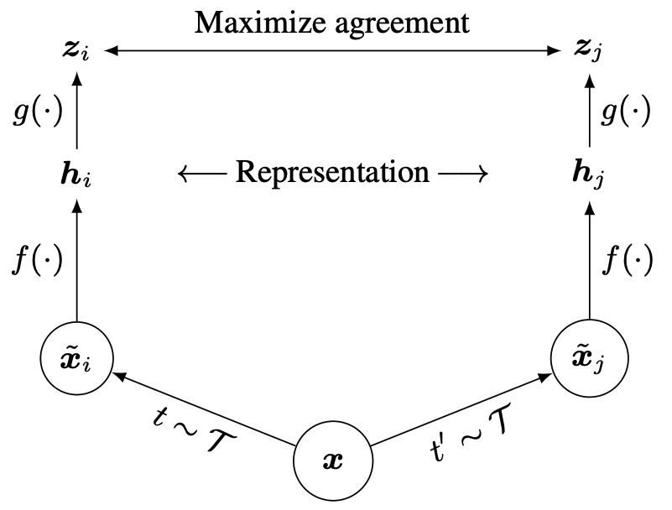
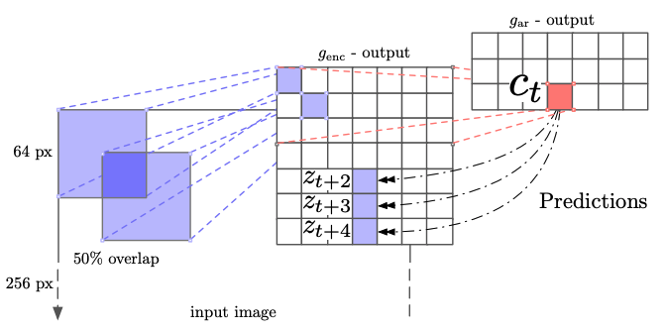
State of the art Self-Supervised Learning
CPC
NPID
PIRL
MOCO
SimCLR
Hénaff, Olivier J., et al. "Data-efficient image recognition with contrastive predictive coding." arXiv preprint arXiv:1905.09272 (2019).
Hénaff, Olivier J., et al. "Data-efficient image recognition with contrastive predictive coding." arXiv preprint arXiv:1905.09272 (2019).
Misra et al. "Self-supervised learning of pretext-invariant representations." CVPR. 2020.
He, Kaiming, et al. "Momentum contrast for unsupervised visual representation learning." CVPR. 2020.
Chen, Ting, et al. "A simple framework for contrastive learning of visual representations." arXiv preprint arXiv:2002.05709 (2020)

Slide 14
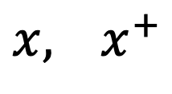
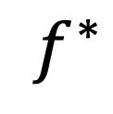
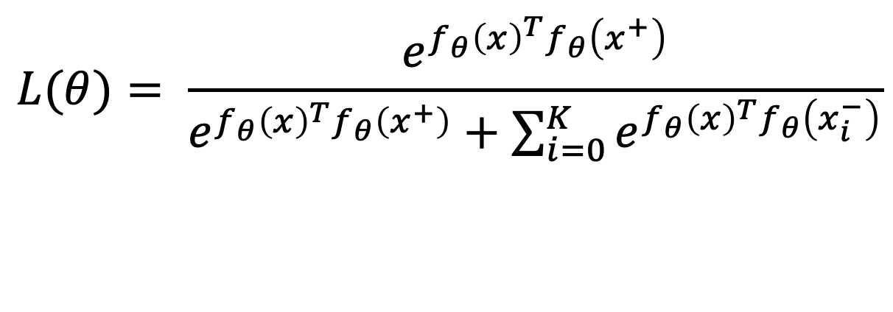
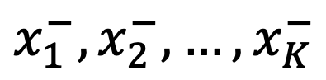
Contrastive Learning in a Nutshell
$$f^{∗}$$
$$x, { x}^{+}$$
Positive Sample Pair
$$x_{1}^{−},x_{2}^{−},…, x_{K}^{−}$$
Negative Samples
$$L(θ)= \frac{e^{f_{θ}{\left(x\right)}^{T}f_{θ}\left(x^{+}\right)}}{e^{f_{θ}{\left(x\right)}^{T}f_{θ}\left(x^{+}\right)}+\sum_{i=0}^{K}{e^{f_{θ}{\left(x\right)}^{T}f_{θ}\left(x_{i}^{−}\right)}}}$$

Slide 15
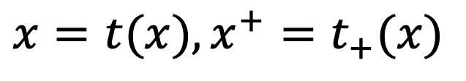
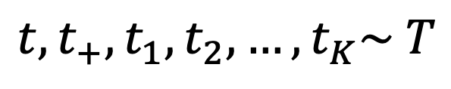
Self-Supervised Learning via Contrastive Learning
$$x=t(x), {x^{+}=t}_{+}(x)$$
Positive Sample Pair
Negative Samples
$$x_{1}^{−}=t_{1}(x_{1}),x_{2}^{−}=t_{2}(x_{2}),…, {x_{K}^{−}=t}_{K}(x_{K})$$
$$t, t_{+},t_{1},t_{2},…,t_{K}\sim T$$
set of random transformations
$$L(θ)= \frac{e^{f_{θ}{\left(x\right)}^{T}f_{θ}\left(x^{+}\right)}}{e^{f_{θ}{\left(x\right)}^{T}f_{θ}\left(x^{+}\right)}+\sum_{i=0}^{K}{e^{f_{θ}{\left(x\right)}^{T}f_{θ}\left(x_{i}^{−}\right)}}}$$
Instance Classification Objective

Slide 16
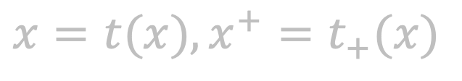
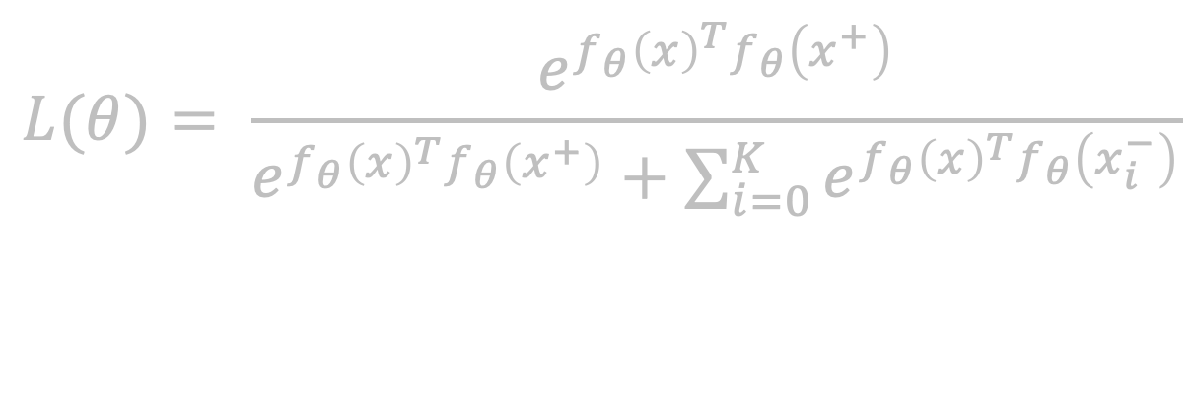
Self-Supervised Learning via Contrastive Learning
$$x=t(x), {x^{+}=t}_{+}(x)$$
Positive Sample Pair
Negative Samples
$$x_{1}^{−}=t_{1}(x_{1}),x_{2}^{−}=t_{2}(x_{2}),…, {x_{K}^{−}=t}_{K}(x_{K})$$
$$t, t_{+},t_{1},t_{2},…,t_{K}\sim T$$
set of random transformations
$$L(θ)= \frac{e^{f_{θ}{\left(x\right)}^{T}f_{θ}\left(x^{+}\right)}}{e^{f_{θ}{\left(x\right)}^{T}f_{θ}\left(x^{+}\right)}+\sum_{i=0}^{K}{e^{f_{θ}{\left(x\right)}^{T}f_{θ}\left(x_{i}^{−}\right)}}}$$
Instance Classification Objective

Slide 17
Instance Classification for SSL
Each image can be transformed to produce a set of images
Horizontal Flip
Color Jitter
Random Crop (generally covering 20-100% of the image)
Grayscale
Each set is treated as a unique class
N Image Dataset = N Classes
Dosovitskiy, Alexey, et al. "Discriminative unsupervised feature learning with exemplar convolutional neural networks." IEEE transactions on pattern analysis and machine intelligence 38.9 (2015): 1734-1747.

Slide 18
Self-Supervised Learning via Contrastive Learning
$$x=t(x), {x^{+}=t}_{+}(x)$$
Positive Sample Pair
Negative Samples
$$x_{1}^{−}=t_{1}(x_{1}),x_{2}^{−}=t_{2}(x_{2}),…, {x_{K}^{−}=t}_{K}(x_{K})$$
$$t, t_{+},t_{1},t_{2},…,t_{K}\sim T$$
set of random transformations
$$L(θ)= \frac{e^{f_{θ}{\left(x\right)}^{T}f_{θ}\left(x^{+}\right)}}{e^{f_{θ}{\left(x\right)}^{T}f_{θ}\left(x^{+}\right)}+\sum_{i=0}^{K}{e^{f_{θ}{\left(x\right)}^{T}f_{θ}\left(x_{i}^{−}\right)}}}$$
Instance Classification Objective

Slide 19
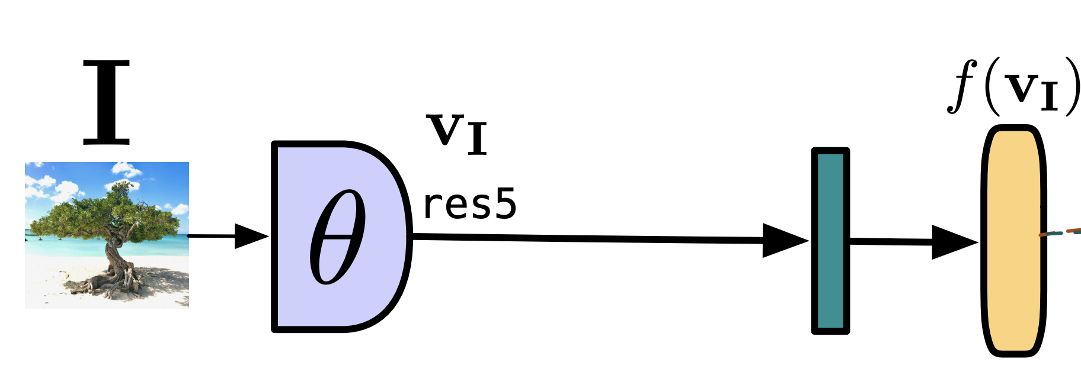
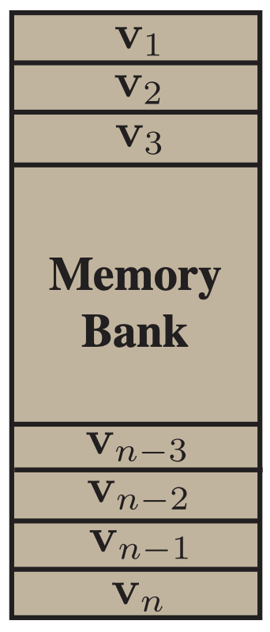
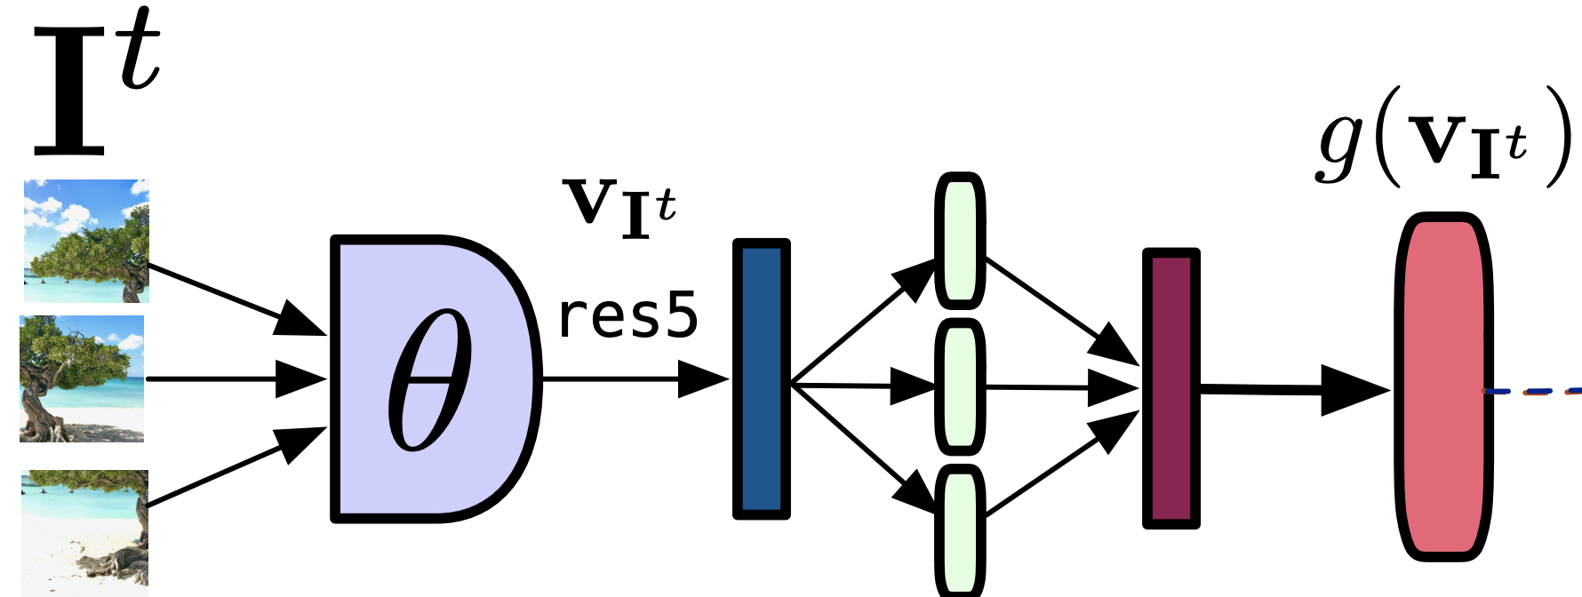
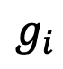
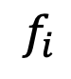
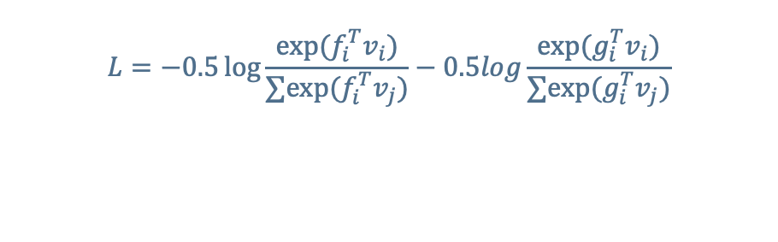
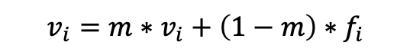
PIRL: Pretext Invariant Representation Learning
cv
cv
Image i
$$f_{i}$$
Cropped patches from Image i
$$g_{i}$$
Shuffle
$$L=−0.5\log{\frac{exp⁡(f_{i}^{T}v_{i})}{∑exp⁡(f_{i}^{T}v_{j})}−0.5log\frac{exp⁡(g_{i}^{T}v_{i})}{∑exp⁡(g_{i}^{T}v_{j})}}$$
$$v_{i}=m∗v_{i}+\left(1−m\right)∗f_{i}$$
Misra, Ishan, and Laurens van der Maaten. "Self-supervised learning of pretext-invariant representations." arXiv preprint arXiv:1912.01991 (2019).

Slide 20
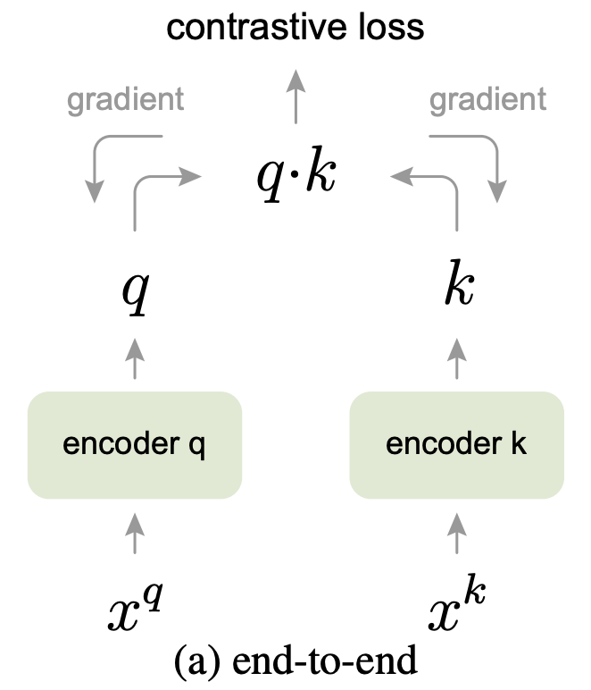
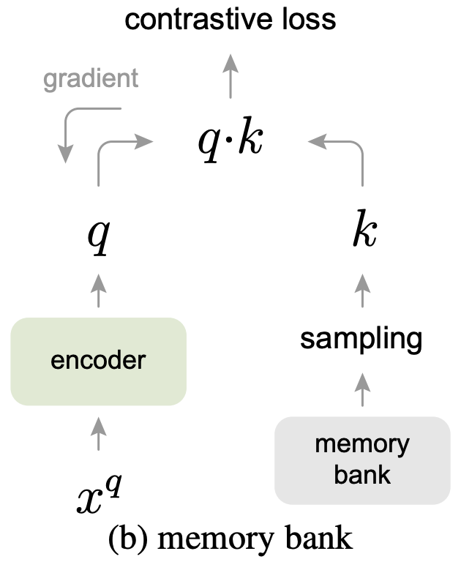
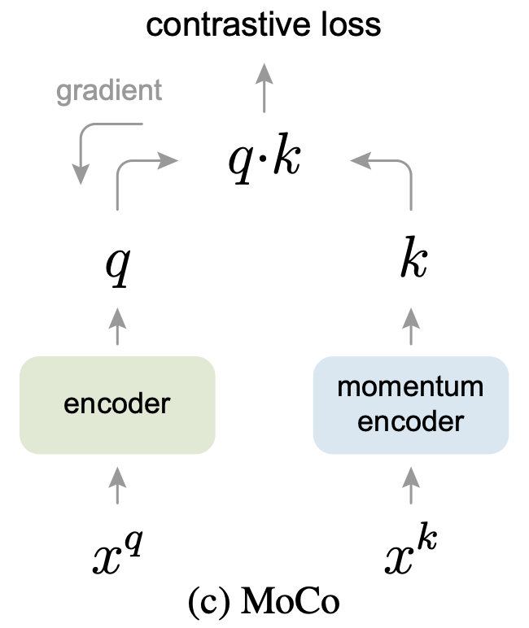
Momentum Contrast (MOCO)
He, Kaiming, et al. "Momentum contrast for unsupervised visual representation learning." arXiv preprint arXiv:1911.05722 (2019).

Slide 21
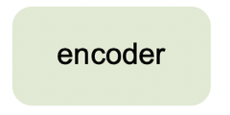
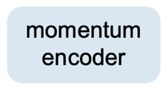
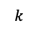
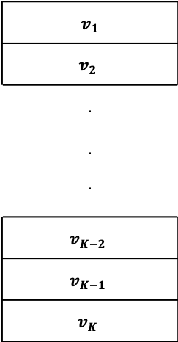
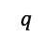
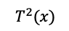
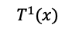
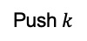
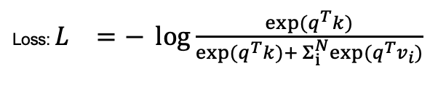
Momentum Contrast (MOCO)
Each Sample:
Queue of K keys
$$T^{1}(x)$$
$$q$$
``Query’’
$v_{1}$
$$v_{2}$$
.
.
.
$$v_{K−2}$$
$$v_{K−1}$$
$$v_{K}$$
$$T^{2}(x)$$
$$k$$
``Key’’
Loss: $L_{}=− \log{\frac{exp⁡(q^{T}k)}{{exp⁡(q^{T}k)+ Σ}_{i}^{N}exp⁡(q^{T}v_{i})}}$
Pop Queue
Push $k$
(Randomly Initialized)
He, Kaiming, et al. "Momentum contrast for unsupervised visual representation learning."
arXiv preprint arXiv:1911.05722 (2019).c

Slide 22
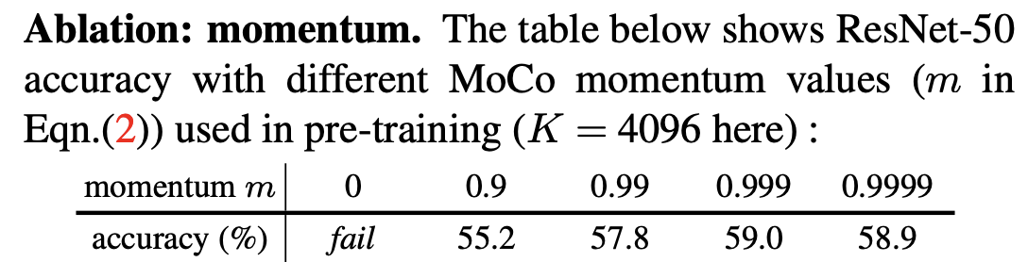
Momentum Contrast (MOCO)
Queue of K keys
Intuition: “we hypothesize that it is desirable to build dictionaries that are: (i) large and (ii) consistent as they evolve during training’’ “A na¨ıve solution is to copy the key encoder fk from the query encoder fq, But this solution yields poor results in experiments. We hypothesize that such failure is caused by the rapidly changing encoder that reduces the key representations’ consistency.’’
$v_{1}$
$$v_{2}$$
.
.
.
$$v_{K−2}$$
$$v_{K−1}$$
$$v_{K}$$
(Randomly Initialized)
He, Kaiming, et al. "Momentum contrast for unsupervised visual representation learning."
arXiv preprint arXiv:1911.05722 (2019).c

Slide 23
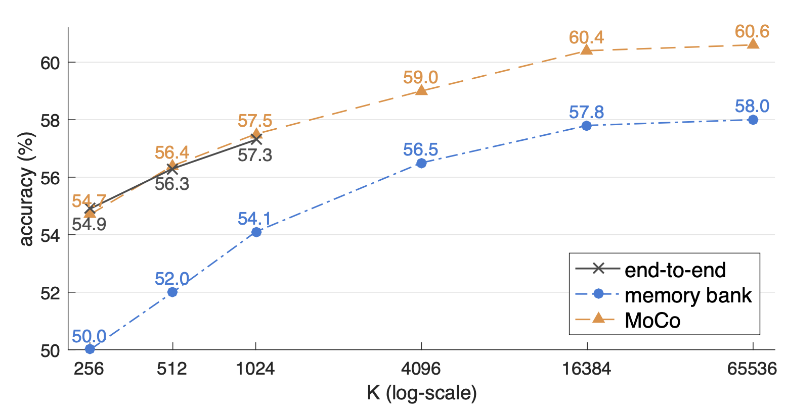
Momentum Contrast (MOCO)

Slide 24
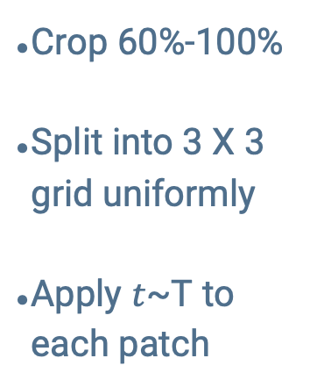


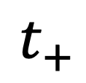
MOCO
PIRL
$$T$$
$$T$$
$$t_{+}$$
Crop 20%-100%
Color Jitter with p=0.8
Grayscale with p=0.2
Gaussian Blur with p=0.5
Horizontal Flip with p=0.2
Crop 20%-100% of the original image
Color Jitter with probability p=0.8
Grayscale with probability p=0.2
Gaussian Blur with probability p=0.5
Random Horizontal Flip with p=0.2
Crop 60%-100%
Split into 3 X 3 grid uniformly
Apply $t$~T to each patch

Slide 25
Evaluating Invariances and not Task Metrics

Slide 26

The Standard Quantitative Evaluation
Linear ImageNet Classification
Object Detection
$$θ$$
…. Keypoint Estimation, Semantic Segmentation, Pose Estimation
Dog!
$$θ$$
Train weights
Train weights

Slide 27
The Standard Quantitative Evaluation
Why are PIRL and MoCo better than an ImageNet trained model?
Why does MoCo outperform PIRL?
What other kinds of domains/tasks would PIRL be better at?
Is there a pattern in the failure cases of the ImageNet model where MoCo or PIRL succeed?
Object Detection Results on VOC07+12 taken from [1]
Method AP^{all} PIRL 54.0 MoCo 55.2 ImageNet Supervised 52.6
1. Misra et al. "Self-supervised learning of pretext-invariant representations." CVPR. 2020.

Slide 28
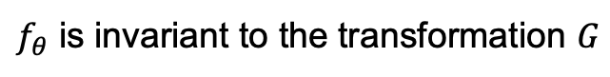
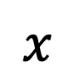


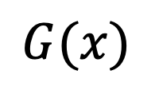


Invariances
$$x$$
$$G(x)$$
$$θ$$
$$θ$$
$$=$$
$$f_{θ}(x)$$
$$f_{θ}(G(x))$$
$f_{θ}$ is invariant to the transformation $G$

Slide 29
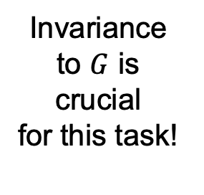
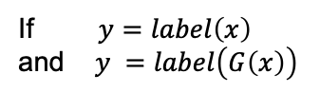
Invariances for Tasks
$$x$$
$$G(x)$$
If $y=label\left(x\right)$ and $y =label\left(G\left(x\right)\right)$
$$θ$$
$$θ$$
Invariance to $G$ is crucial for this task!
$$=$$
$$f_{θ}(x)$$
$$f_{θ}(G(x))$$
$f_{θ}$ is invariant to the transformation $G$

Slide 30
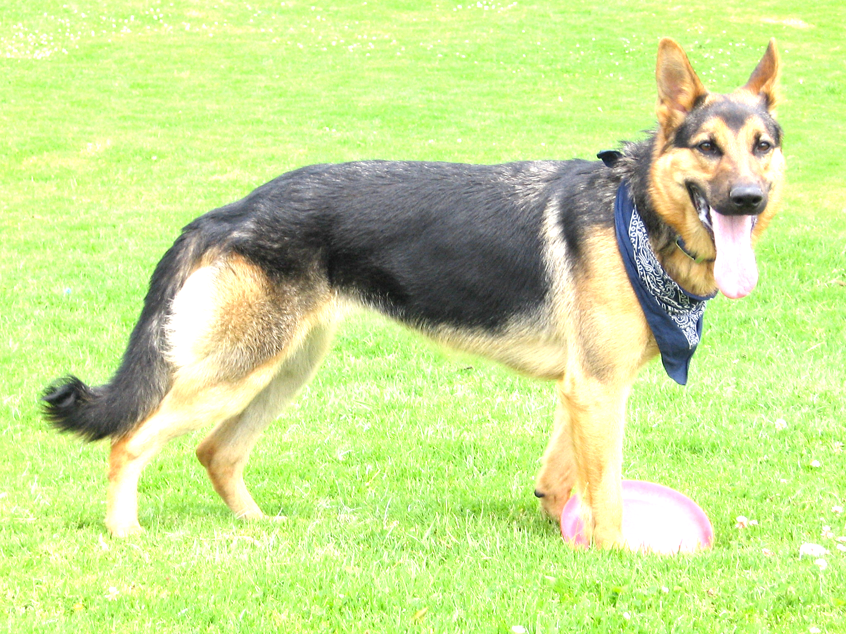


Invariances for Object Recognition Tasks
Viewpoint Invariance
$$=$$
$$=$$
Instance Invariance
Occlusion Invariance
Illumination Invariance

Slide 31
Measuring Invariances - Trajectories
Vary the transformation, keeping the other variables (category, illumination, etc) constant
Occlusion Trajectories created from the GOT-10K dataset

Slide 32
Measuring Invariances - Trajectories
A set of samples where the considered transformation varies,
keeping the other variables (category, illumination, etc) constant (approximately)
Occlusion Trajectories created from the GOT-10K dataset

Slide 33
Measuring Invariances - Trajectories
A set of samples where the considered transformation varies,
keeping the other variables (category, illumination, etc) constant (approximately)
Viewpoint+Instance Change Trajectories created from the Pascal3D dataset
Instance Change Trajectories created from the Pascal3D dataset

Slide 34
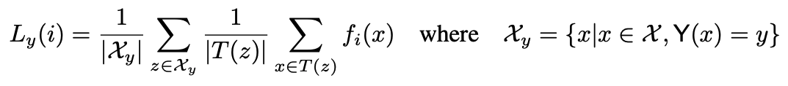
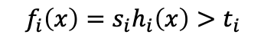
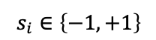
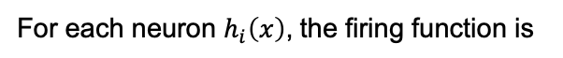
Measuring Invariances - Metric
For each neuron $h_{i}\left(x\right)$, the firing function is
$$f_{i}\left(x\right)=s_{i}h_{i}\left(x\right)>t_{i}$$
$$s_{i}∈\left\{−1, +1\right\}$$
For each neuron choose $s_{i}$ and $t_{i}$ such that $f_{i} = 1$for approximately $\frac{1}{\#classes}$ samples*
For a class y, the local firing rate of neuron $i$ is defined as:
Mean over samples of class y
Mean over trajectory
of the samples
For each class choose Top-K mean average $L_{y}\left(i\right)$ neurons, then compute mean over classes
*only for uniformly distributed datasets, check paper for a more general formulation

Slide 35
Occlusion and Viewpoint Invariance
Dataset | Method | Occlusion |  | Viewpoint |  | Instance
 |  | Top-10 | Top-25 | Top-10 | Top-25 | Top-10 | Top-25
Imagenet | Sup. R50 | 80.89 | 74.21 | 89.54 | 82.62 | 66.11 | 59.44
Imagenet | MOCOv2 | 84.19 | 77.88 | 85.15 | 75.08 | 62.49 | 55.01
Imagenet | PIRL | 84.46 | 78.38 | 85.8 | 76.08 | 52.97 | 46.79
MoCo has a relatively conservative cropping strategy compared to PIRL
Note that while ImageNet training also follows an aggressive cropping strategy, the objective doesn’t explicitly force the different samples to share the same representation
i.e. the representation could be distributed
ImageNet objective explicitly pulls together different viewpoints of the same category
ImageNet objective explicitly pulls together different instances of the same category
Checkout the paper for quantification of other invariances

Slide 36
Augmentations and Dataset Biases

Slide 37
Aggressive Augmentation
PIRL further divides these into 3x3 grids
Original Image
Possible Augmentation Outputs

Slide 38
Aggressive Augmentation
Why do these representations work for Object Recognition tasks?
Possible Augmentation Outputs

Slide 39
Aggressive Augmentation
Why do these representations work for Object Recognition tasks?
Training Dataset Bias
Capacity of the Neural Networks
Possible Augmentation Outputs

Slide 40
Training Dataset Bias
ImageNet Dogs
ImageNet Chairs
vs
ImageNet Tables

Slide 41
Diagnostic Experiments
MSCOCO follows a more natural distribution of images, so let’s train on that!

Slide 42
Diagnostic Experiment Results
Dataset | Method
ImageNet 10% | MOCOv2
MSCOCO | MOCOv2
MSCOCO Boxes | MOCOv2

Slide 43
Diagnostic Experiment Results
Confirmation of training dataset bias!
Dataset | Method | ImageNet
 |  | Top-1 Acc
ImageNet 10% | MOCOv2 | 38.53
MSCOCO | MOCOv2 | 33.64
MSCOCO Boxes | MOCOv2 | 34.24

Slide 44
Diagnostic Experiment Results
Confirmation of training dataset bias! What’s going on here?
Dataset | Method | ImageNet | Pascal VOC
 |  | Top-1 Acc | Mean AP
ImageNet 10% | MOCOv2 | 38.53 | 62.32
MSCOCO | MOCOv2 | 33.64 | 64.39
MSCOCO Boxes | MOCOv2 | 34.24 | 59.6

Slide 45
Test Dataset Bias – Co-occurrence statistics
Example: Dining Table Images from MSCOCO
Also generally contain chairs!
Not distinguishing chairs and tables, doesn’t hurt on test-sets with similar co-occurrence statistics
About 50% of the table images in MSCOCO contain chairs

Slide 46
Diagnostic Experiment Results
Training dataset bias confirmed again!
Dataset | Method | ImageNet | Pascal | Pascal Cropped Boxes
 |  | Top-1 Acc | Mean AP | Mean AP
ImageNet 10% | MOCOv2 | 38.53 | 62.32 | 73.85
MSCOCO | MOCOv2 | 33.64 | 64.39 | 71.94
MSCOCO Boxes | MOCOv2 | 34.24 | 59.6 | 75.29

Slide 47
Diagnostic Experiment Results
Alternative theory: drop in performance could be the domain change i.e. full scene images are shown during training, but cropped boxes are used for testing.
In order to discredit this explanation, we create a separate test-dataset consisting of the subset of Pascal VOC07 test images which depict either table or chair in the image, but not both. We observe that on the table vs chair full image classification task, the representation trained on COCO-Boxes outperforms full COCO-image pre-training. Specifically, COCO-R50 has mAP of 73.64 and COCO-Boxes has mAP of 74.92

Slide 48

Learning from Videos

Slide 49




Learning from Videos

Slide 50

Learning from Videos

Slide 51





Learning from Videos
Track region proposals using an ImageNet based MoCo-v2 representation
$$z_{1}^{1}$$
$$z_{2}^{1}$$
$$z_{3}^{1}$$
$$z_{4}^{1}$$
$$z_{5}^{1}$$

Slide 52

Learning from Videos
Track region proposals using an ImageNet based MoCo-v2 representation
$$z_{1}^{1}$$
$$z_{2}^{1}$$
$$z_{3}^{1}$$
$$z_{4}^{1}$$
$$z_{5}^{1}$$

Slide 53
Learning from Videos
MoCo-v2 trained on TrackingNet dataset
Dataset | Pascal | Pascal Cropped Boxes | ImageNet | ADE20K
 | Mean AP | Mean AP | Top-1 | Mean IOU | Pixel Acc.
Baseline MOCOv2 | 61.80 | 70.91 | 30.33 | 14.69 | 61.78
Frame Temp. Invariance | 63.89 | 72.17 | 29.34 | 14.41 | 61.85
Ground Truth Tracks | 66.21 | 76.16 | 37.45 | 14.69 | 61.78
Region Tracker | 66.47 | 75.86 | 36.51 | 15.28 | 63.29

Slide 54
Learning from Videos
MoCo-v2 trained on TrackingNet dataset
Method | Occlusion |  | Viewpoint |  | Instance
 | Top-10 | Top-25 | Top-10 | Top-25 | Top-10 | Top-25
Baseline MOCOv2 | 81.73 | 75.35 | 81.55 | 71.71 | 43.76 | 40.43
Frame Temp. Invariance | 79.92 | 73.33 | 83.87 | 74.86 | 42.98 | 39.42
Ground Truth Tracks | 81.52 | 74.6 | 84.82 | 75.3 | 47.51 | 42.93
Region Tracker | 83.26 | 76.52 | 84.97 | 76.18 | 48.81 | 44.38

Slide 55
Key Takeaways
The field has converged to working with the “instance classification” problem for self-supervised learning
Current methods of instance classification heavily rely on the training set bias
Measuring invariances provides a clearer understanding of the functionality of the representations
Videos could serve as a useful domain to induce additional desirable invariances

Slide 56
Thank you!

